Slide 1
Portable Shoulder Physical Therapy Device
-Mithil Raut

Slide 2
Background
As people age, they tend to lose flexibility, strength and often their balance, so maintaining the desired level of fitness becomes increasingly challenging.
People playing racquet sports put a strain on their muscles in arms and shoulder. Ex: Tennis, Squash, Racquetball, Table tennis, Baseball etc.

Slide 3
Causes of shoulder pain
Rotator cuff tendinopathy
Impingement
Rotator cuff tear
Adhesive capsulitis Frozen Shoulder
Glenohumeral arthritis

Slide 4
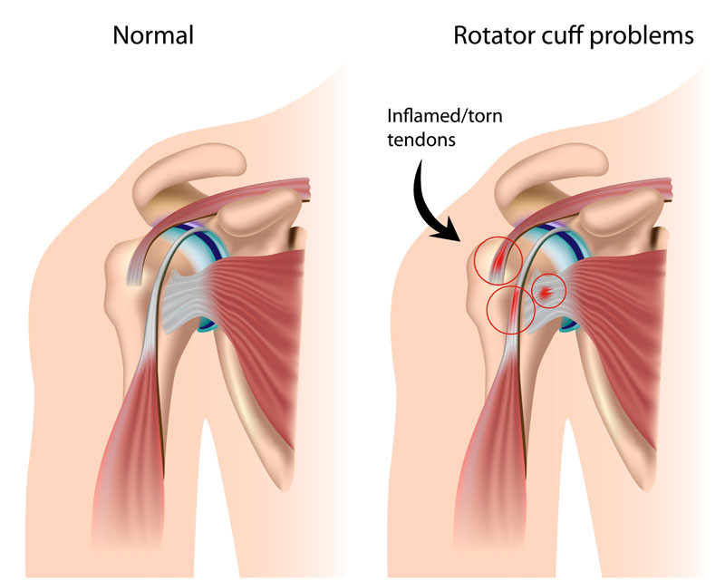

Slide 5
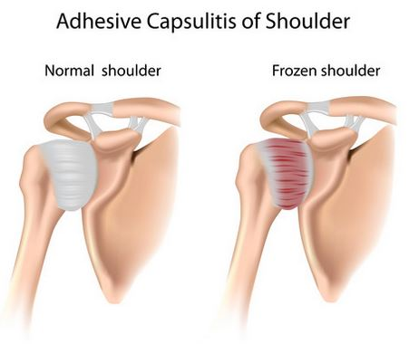

Slide 6
Common methods used to fix these problems
Shoulder surgery
Physical Therapy
RICE Rest, Ice, Compress, and Elevate
Shoulder sling to keep pressure off joint

Slide 7
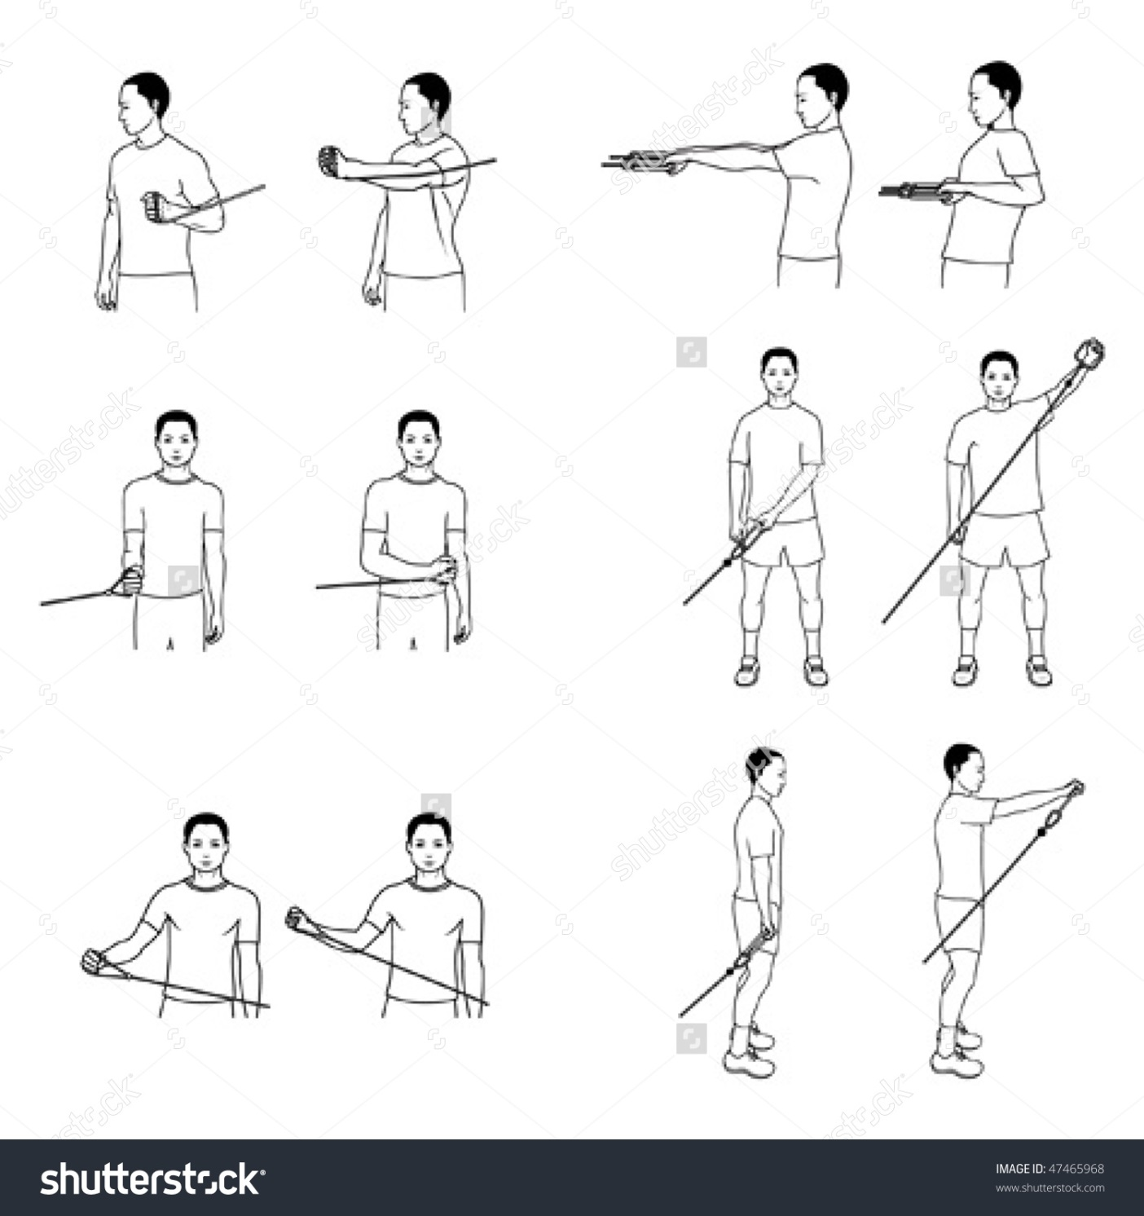
Types of exercises

Slide 8
Use cases
Elder people, generally in the age range 45-80.
People with shoulder or arm injury.
Fitness centres

Slide 9
Goals
Create device that will be lightweight, portable, and easy to install.
Indicate the force exerted, number of sets completed, angle of pull, calories burned.
Test multiple runs of the different components of the device to make sure it is practical and easy to use.
Create a product that may be tested by physical therapists in FitRec.

Slide 10
Components of device
Clamp/vise like mechanism to retrofit design to every door frame/table.
Make it lightweight so use of plastics may be ideal for the body of the device
Pressure sensor that will measure the force exerted over a period of time to find the power and energy exerted by the user.
Create a user interface to allow the user to be able to know how much energy they burned and when the workout will be completed.
Resistance bands that will be used to workout the muscles around the shoulder to increase strength

Slide 11
Test case scenarios
Force meter does it work (time under tension)
Vise-grip will not damage door
Can it retrofit to any door frame/table
Ease of use, is it comfortable to use

Slide 12
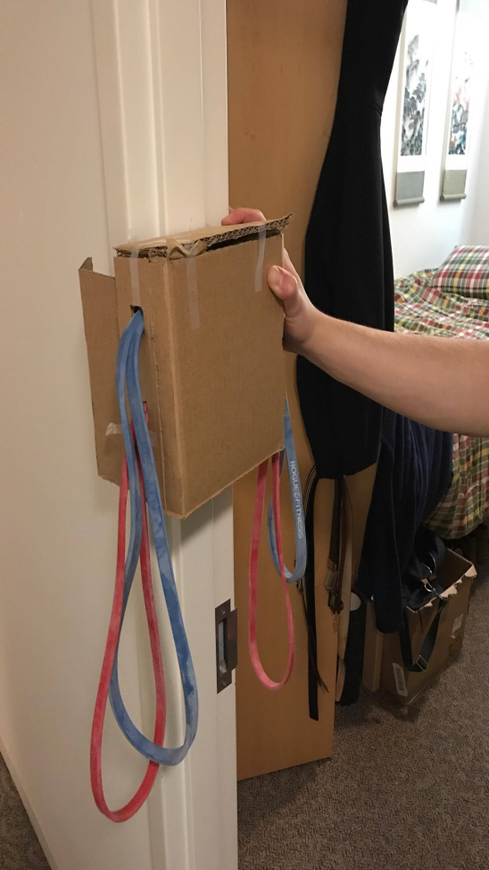
How it would look (rough)

